Slide 2

Mentoring Hub Subsystem Output
Tai Dang | 24.06.2024

Slide 3

Agenda
Mindmap
Usecase diagram
UI&UX design/Database Design
Q&A

Slide 4
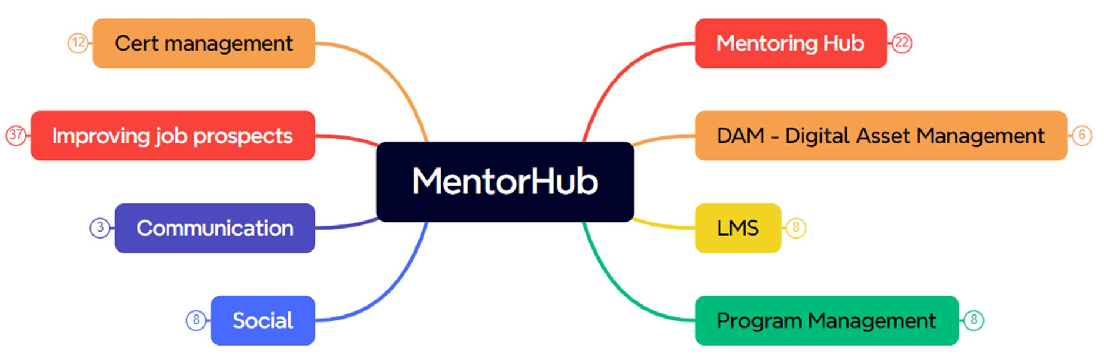

Slide 5
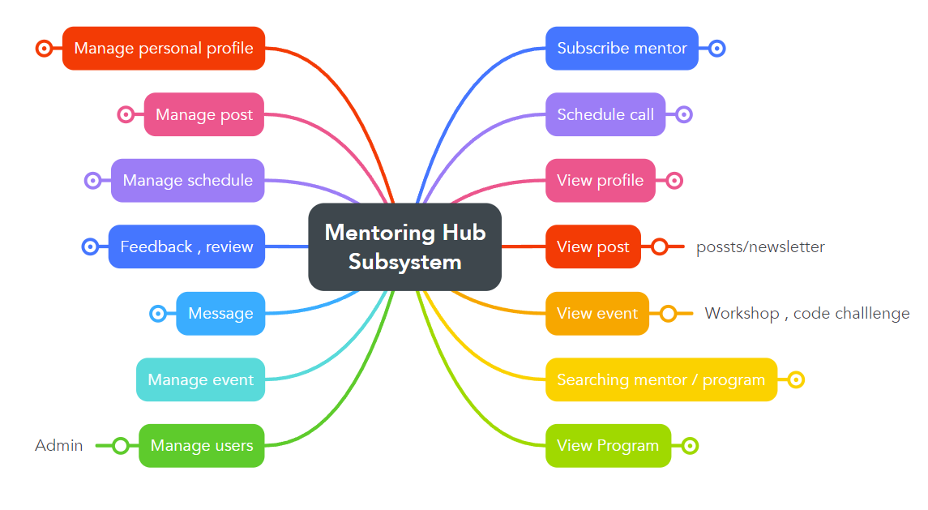

Slide 6
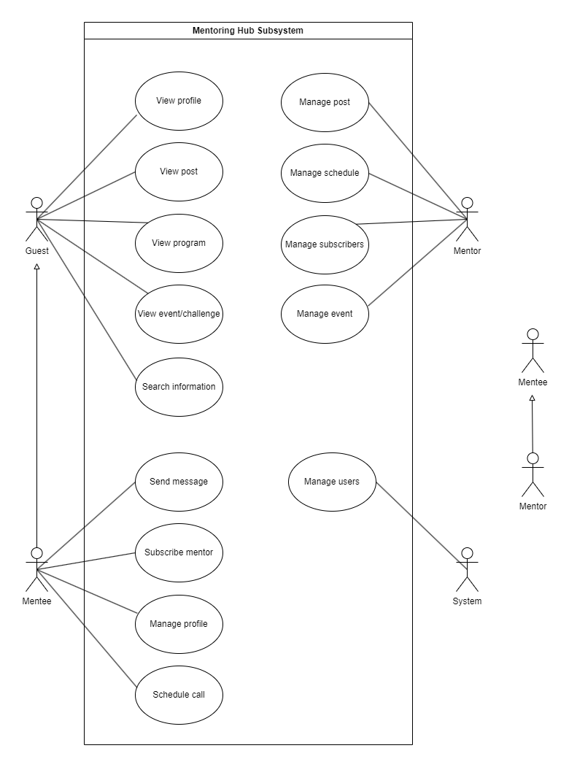
Use case diagram

Slide 7
Mentor List
Mentor Profile
Mentor manage followers
Mentor manage Post/Event
Mentee Profile
Admin Dashboard

Slide 8
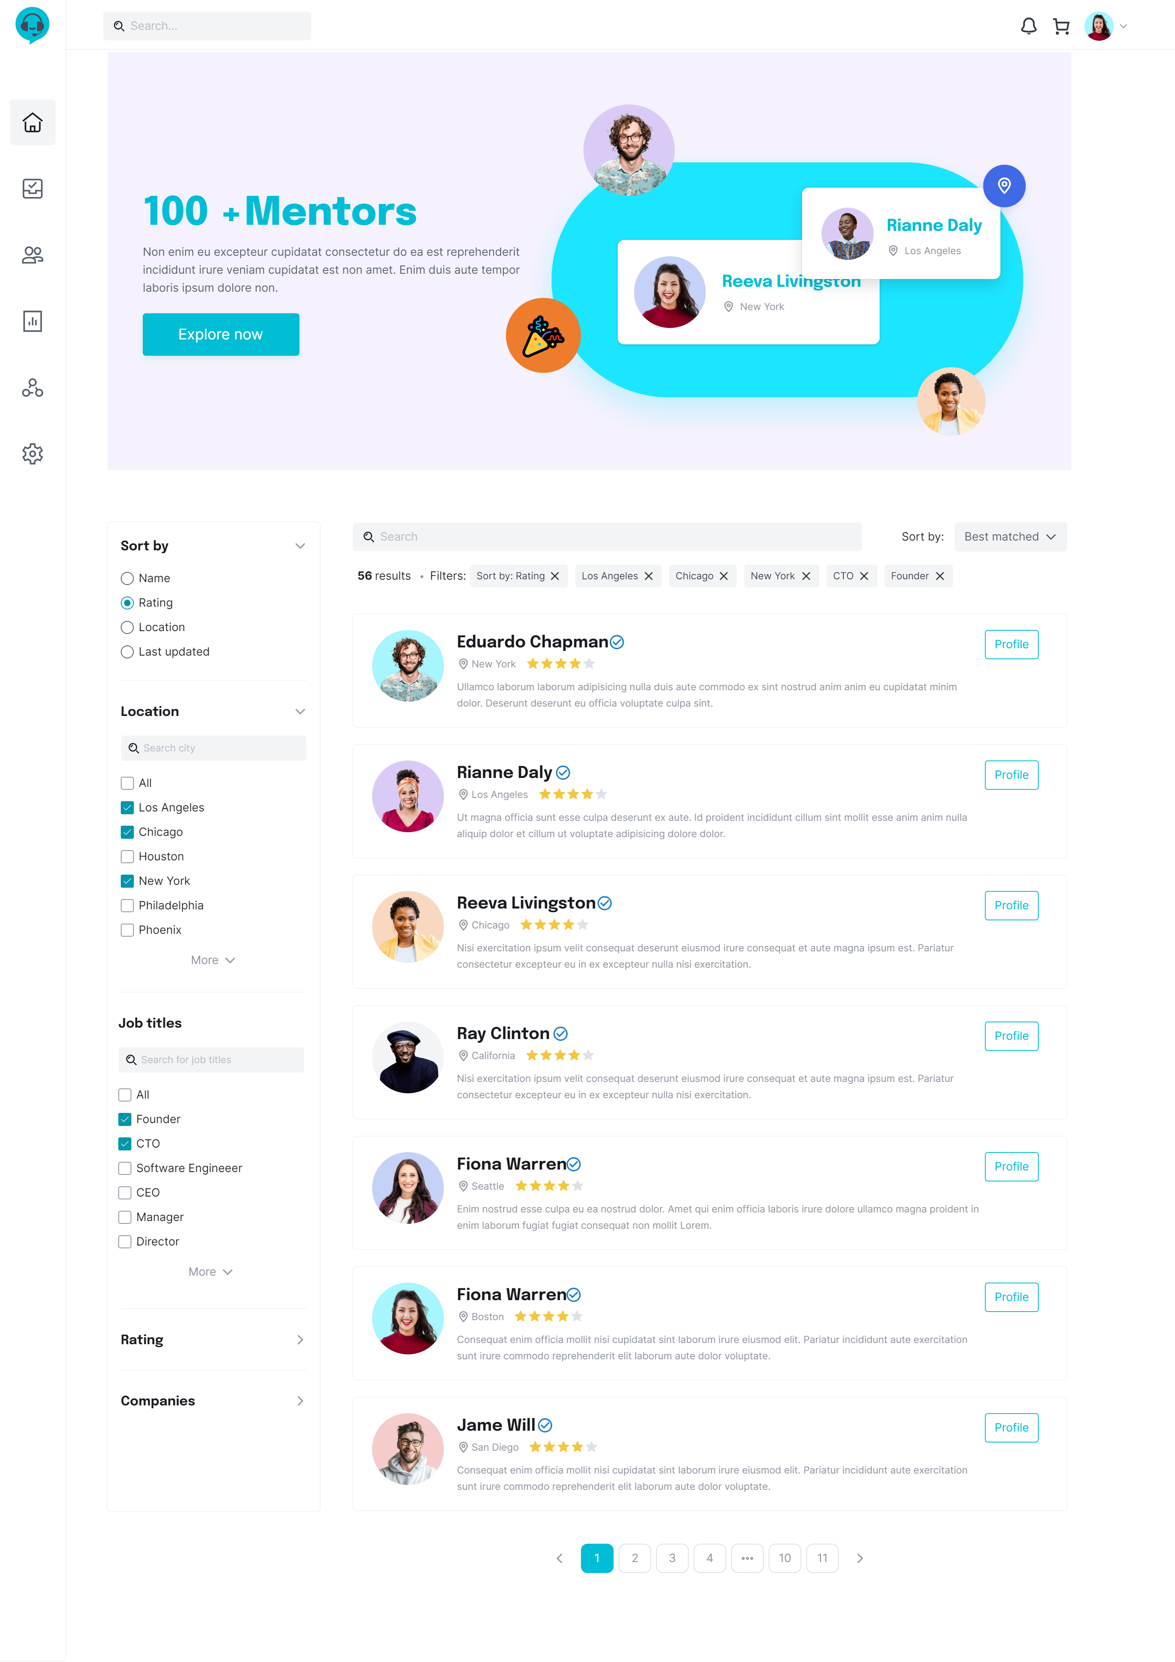
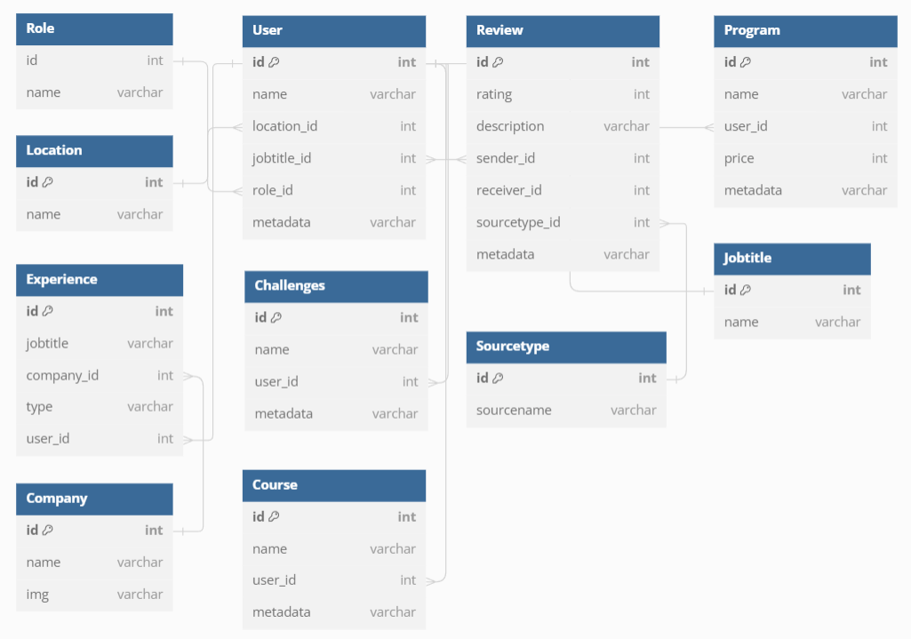
Mentor List
Notes:
## lay mentor rating theo location va top rating
```sql
SELECT
u.id, u.name, l.name as location, u.role_id , j.name as jobtitle
,COALESCE(AVG(f.rating),0) as average_rating
FROM Userr u
JOIN Jobtitle j ON u.jobtitle_id = j.id
JOIN Location l on u.location_id = l.id
LEFT JOIN Program p ON u.id = p.mentor_id
LEFT JOIN Challenge c ON u.id = c.mentor_id
LEFT JOIN Course co ON u.id = co.mentor_id
LEFT JOIN Review f ON f.receiver_id = p.id OR f.receiver_id = c.id OR f.receiver_id = co.id
WHERE u.location_id = 'L2' AND u.role_id = 'R1'
GROUP BY u.id, u.name, location, jobtitle, u.role_id
ORDER BY average_rating DESC;
```
## Lay mentor theo top rating (program , challenges , course)
```sql
SELECT
u.id,
u.name,
u.location_id,
j.name AS jobtitle,
u.role_id,
COALESCE(AVG(f.rating), 0) AS average_rating
FROM Userr u
JOIN Jobtitle j ON u.jobtitle_id = j.id
LEFT JOIN Program p ON u.id = p.mentor_id
LEFT JOIN Challenge c ON u.id = c.mentor_id
LEFT JOIN Course co ON u.id = co.mentor_id
LEFT JOIN Review f ON f.receiver_id = p.id OR f.receiver_id = c.id OR f.receiver_id = co.id
WHERE u.role_id = 'R1'
GROUP BY u.id, u.name, u.location_id, j.name, u.role_id
ORDER BY average_rating DESC;
```
## Lay mentor theo jobtitle va top rating
```sql
SELECT
u.id, u.name, u.location_id, j.name as jobtitle, u.role_id
,COALESCE(AVG(f.rating),0) as average_rating
FROM Userr u
JOIN Jobtitle j ON u.jobtitle_id = j.id
LEFT JOIN Program p ON u.id = p.mentor_id
LEFT JOIN Challenge c ON u.id = c.mentor_id
LEFT JOIN Course co ON u.id = co.mentor_id
LEFT JOIN Review f ON f.receiver_id = p.id OR f.receiver_id = c.id OR f.receiver_id = co.id
WHERE u.role_id = 'R1' and j.name = 'Senior Software Engineaer'
GROUP BY u.id, u.name, u.location_id, j.name, u.role_id
ORDER BY average_rating DESC;
```

Slide 9
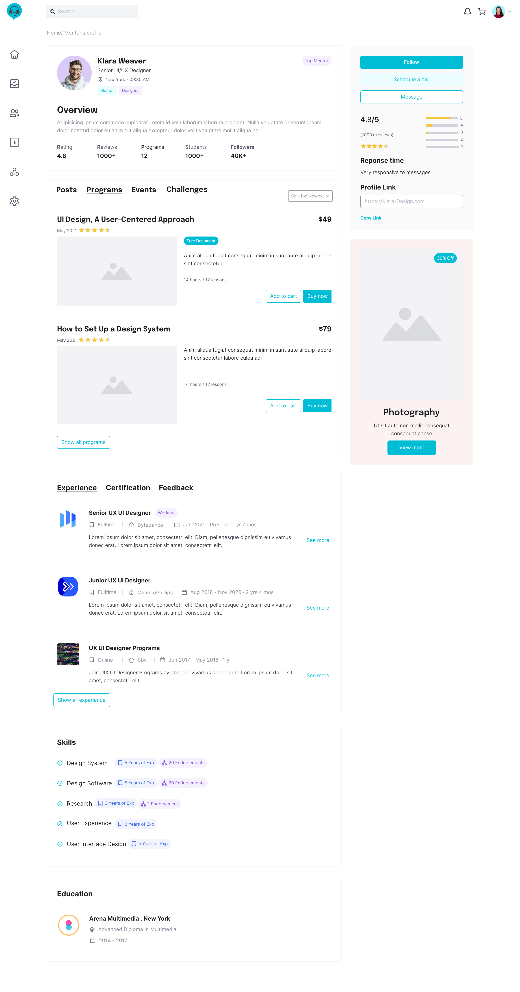
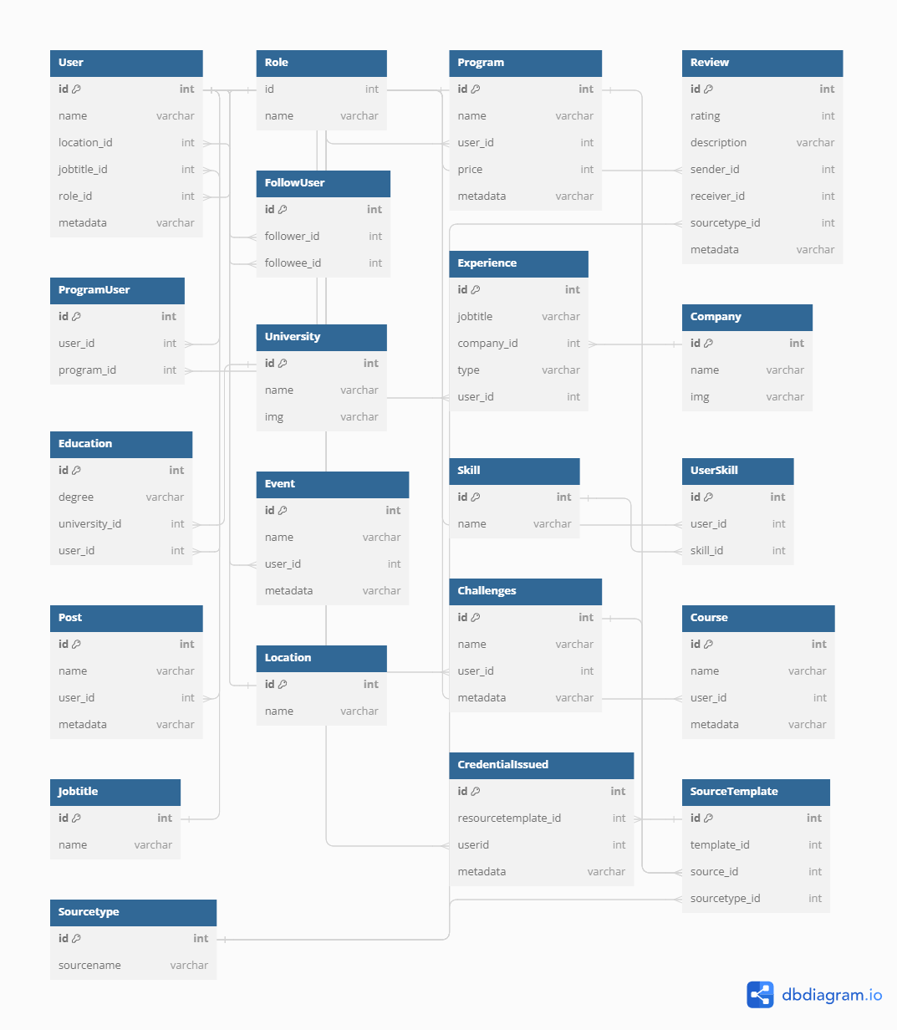
Mentor Profile
Notes:
## lay name , jobtitle , role , totalprogram , avgrating , totalfollowers , totalstudent, totalfeedback cua mentor
```sql
SELECT
u.id,
u.name,
j.name as jobtitle,
u.location_id,
u.role_id,
(SELECT COUNT(*)
FROM Program
WHERE mentor_id = 'U1') as total_programs,
(SELECT COUNT(*)
FROM Review fm
LEFT JOIN Program p ON fm.receiver_id = p.id
LEFT JOIN Challenge c ON fm.receiver_id = c.id
LEFT JOIN Course co ON fm.receiver_id = co.id
WHERE p.mentor_id = 'U1' OR c.mentor_id = 'U1' OR co.mentor_id = 'U1') as total_feedback,
(SELECT COUNT(DISTINCT pu.user_id)
FROM Program p
JOIN ProgramUser pu ON p.id = pu.program_id
WHERE p.mentor_id = 'U1') as total_users_in_programs,
(SELECT COUNT(*)
FROM Follow
WHERE followee_id = 'U1') as total_followers,
(SELECT
COALESCE(AVG(fm.rating),0)
FROM Review fm
LEFT JOIN Program p ON fm.receiver_id = p.id
LEFT JOIN Challenge c ON fm.receiver_id = c.id
LEFT JOIN Course co ON fm.receiver_id = co.id
WHERE p.mentor_id = 'U1' OR c.mentor_id = 'U1' OR co.mentor_id = 'U1') as average_rating
FROM Userr u
JOIN Jobtitle j on u.jobtitle_id = j.id
WHERE u.id = 'U1';
```
## lay tat ca program cua 1 user va avg(rating)
```sql
SELECT
p.id,
p.name,
p.price,
AVG(f.rating) AS total_rating
FROM
Review f
JOIN
Program p ON f.receiver_id = p.id
JOIN
Userr sender ON f.sender_id = sender.id
WHERE
p.mentor_id = 'U2'
GROUP BY
p.id,
p.name,
p.price
ORDER BY
total_rating DESC;
```
## lay experience cua 1 user
```sql
SELECT
j.name as jobtitle,
c.name AS company_name,
e.type
FROM
Experience e
JOIN
Company c ON e.company_id = c.id
JOIN
Jobtitle j on e.jobtitle_id = j.id
WHERE
e.user_id = 'U4'
UNION
SELECT
p.name AS jobtitle,
u.name AS company_name,
'Training' AS type
FROM
ProgramUser pu
JOIN
Program p ON pu.program_id = p.id
JOIN
Userr u ON p.mentor_id = u.id
WHERE
pu.user_id = 'U4' and pu.status ='Completed';
```
## lay cert cua 1 user
```sql
SELECT ci.id AS CertID,
ci.credentialcode,
ci.certified_at,
COALESCE(p.name, c.name, ch.name) AS CertName
FROM CredentialIssued ci
JOIN SourceTemplate st ON ci.sourcetemplate_id = st.id
LEFT JOIN Program p ON st.source_id = p.id AND st.sourcetype_id = 'S3'
LEFT JOIN Course c ON st.source_id = c.id AND st.sourcetype_id = 'S1'
LEFT JOIN Challenge ch ON st.source_id = ch.id AND st.sourcetype_id = 'S2'
WHERE ci.user_id = 'U3';
```
## Select tat ca feedback from programs of mentor
```sql
SELECT f.rating,f.content
FROM Review f
JOIN Program p on f.receiver_id = p.id
JOIN Userr u on p.mentor_id = u.id
WHERE u.id ='U2'
```
## Select skill
```sql
Select s.name
From Skill s
JOIN UserSkill us on s.id = us.skill_id
JOIN Userr u on us.user_id = u.id
WHERE u.id ='U1'
```

Slide 10
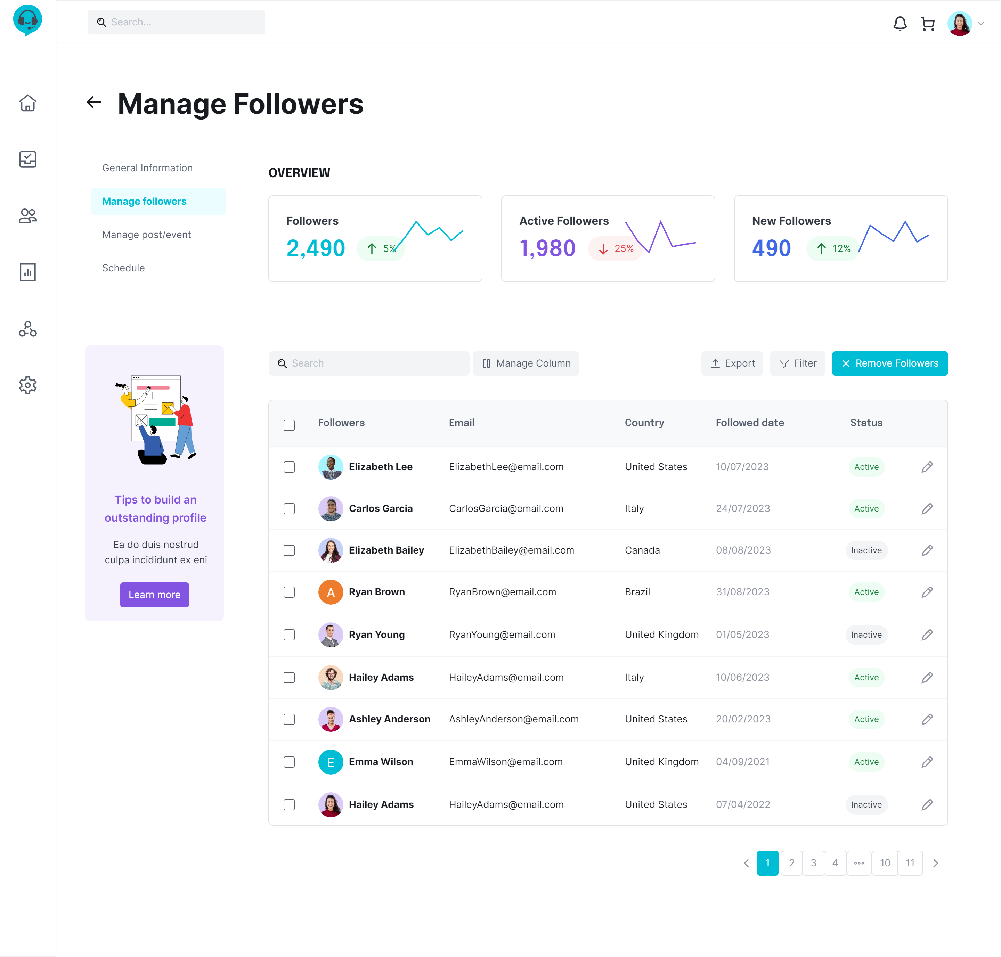
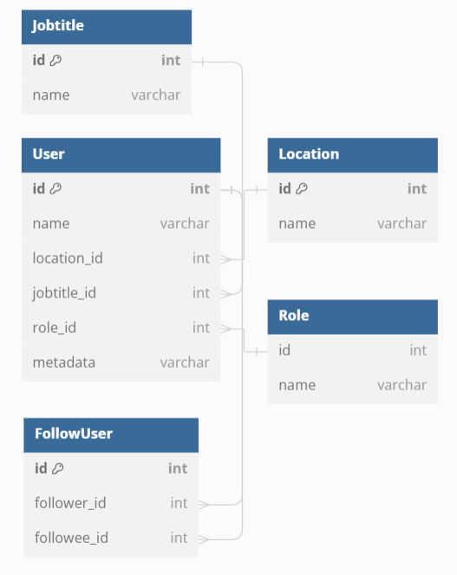
Mentor Manage Followers
Notes:
## SELECT ALL FOLLOWER
```sql
SELECT *
FROM Follow f
JOIN Userr u on f.follower_id = u.id
WHERE followee_id = 'U1'
```
## Dem so luong tat ca follower
```sql
SELECT count(*)
FROM Follow f
WHERE followee_id = 'U1'
```

Slide 11
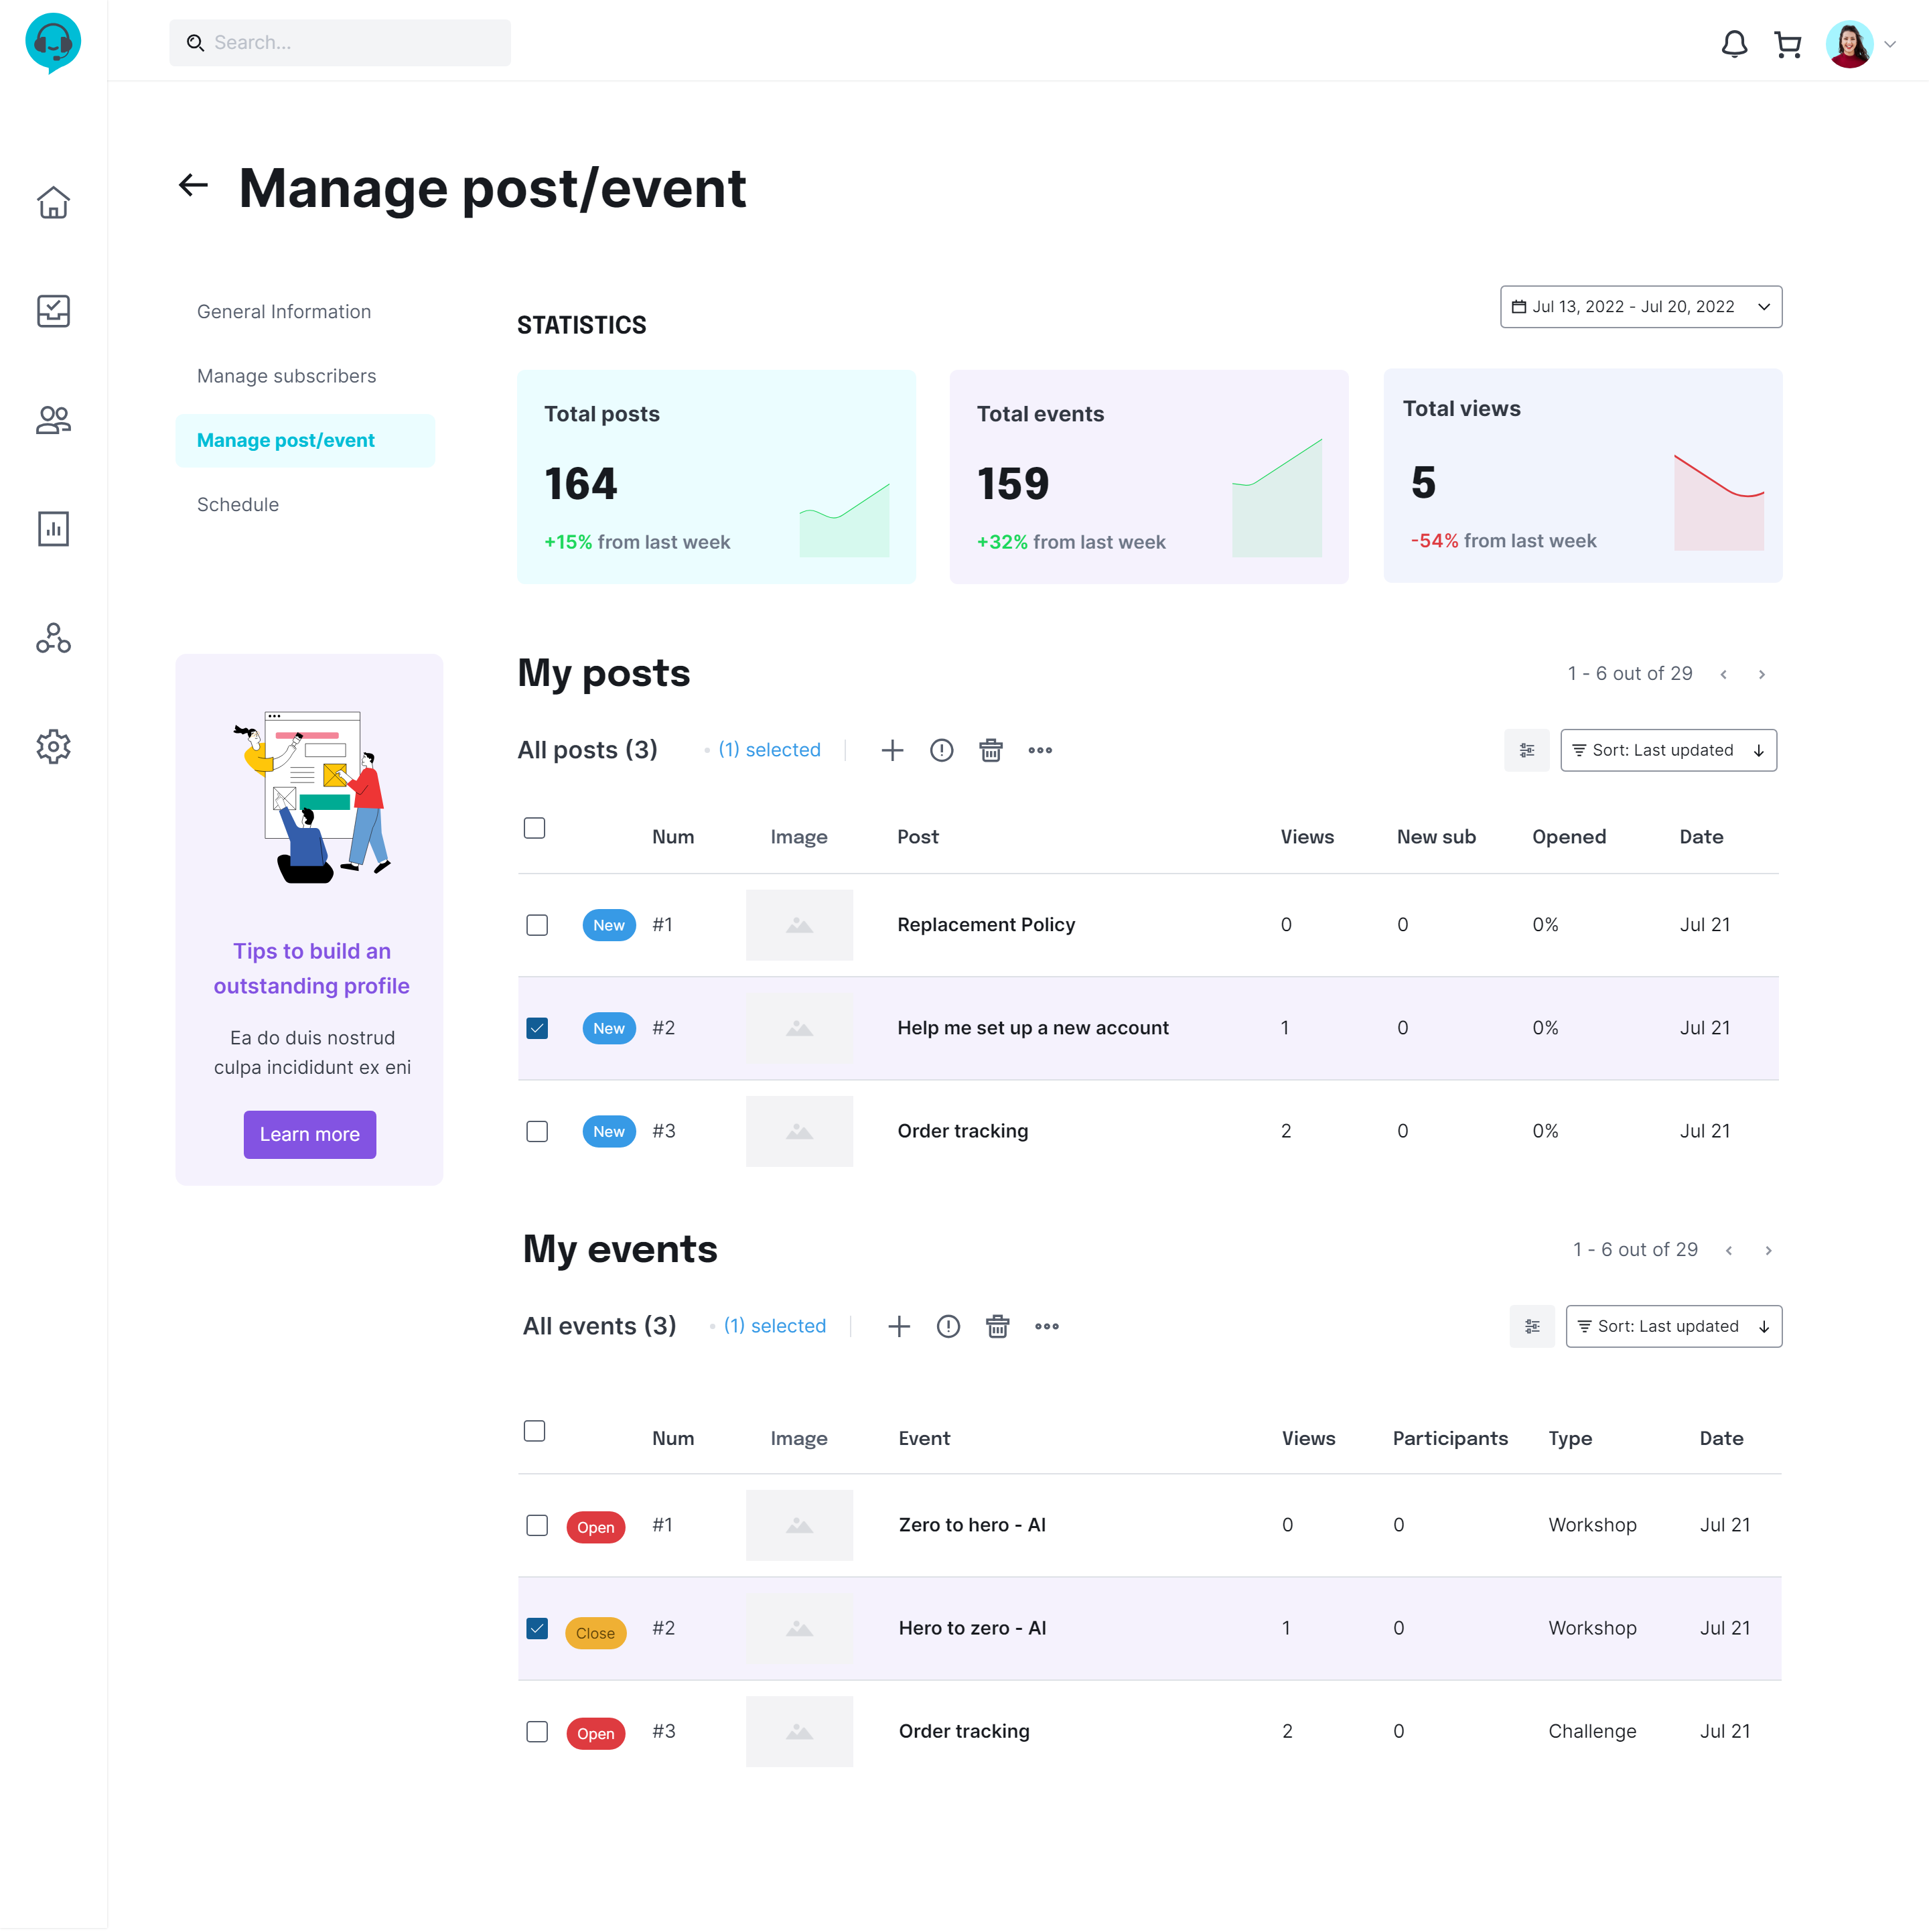
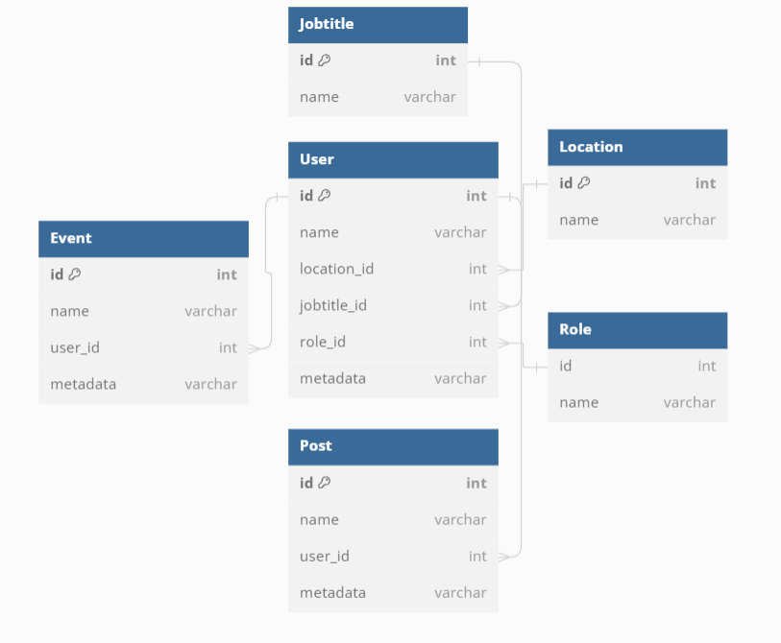
Mentor Manage Post/Event

Slide 12
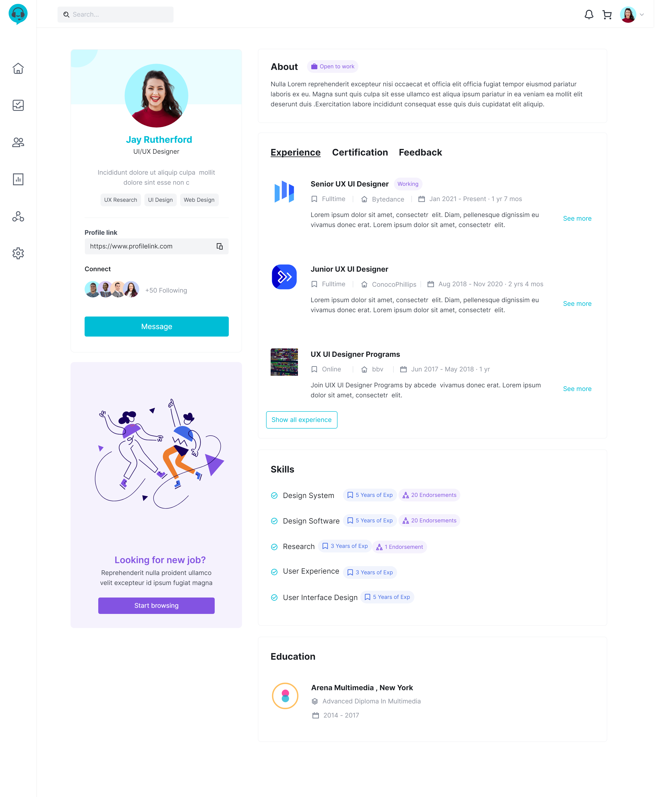
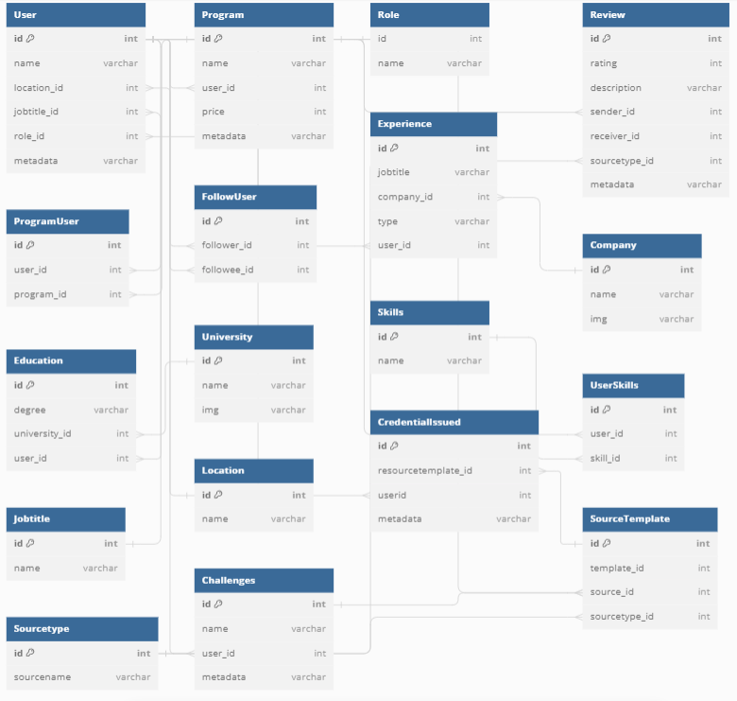
Mentee Profile
Notes:
## select thong tin co ban cua mentee và số lượng người mentee đang theo dõi
```sql
SELECT
u.id,
u.name,
j.name as jobtitle,
l.name as location,
r.name as role,
(SELECT COUNT(*)
FROM Follow
WHERE follower_id = 'U3') as total_followers
FROM Userr u
JOIN Jobtitle j on u.jobtitle_id = j.id
JOIN Location l on u.location_id = l.id
JOIN Role r on u.role_id = r.id
WHERE u.id = 'U3’;
## lay cert cua 1 user
```sql
SELECT ci.id AS CertID,
ci.credentialcode,
ci.certified_at,
COALESCE(p.name, c.name, ch.name) AS CertName
FROM CredentialIssued ci
JOIN SourceTemplate st ON ci.sourcetemplate_id = st.id
LEFT JOIN Program p ON st.source_id = p.id AND st.sourcetype_id = 'S3'
LEFT JOIN Course c ON st.source_id = c.id AND st.sourcetype_id = 'S1'
LEFT JOIN Challenge ch ON st.source_id = ch.id AND st.sourcetype_id = 'S2'
WHERE ci.user_id = 'U3';
```
## lay experience cua 1 user
```sql
SELECT
j.name as jobtitle,
c.name AS company_name,
e.type
FROM
Experience e
JOIN
Company c ON e.company_id = c.id
JOIN
Jobtitle j on e.jobtitle_id = j.id
WHERE
e.user_id = 'U4'
UNION
SELECT
p.name AS jobtitle,
u.name AS company_name,
'Training' AS type
FROM
ProgramUser pu
JOIN
Program p ON pu.program_id = p.id
JOIN
Userr u ON p.mentor_id = u.id
WHERE
pu.user_id = 'U4' and pu.status ='Completed';
```

Slide 13
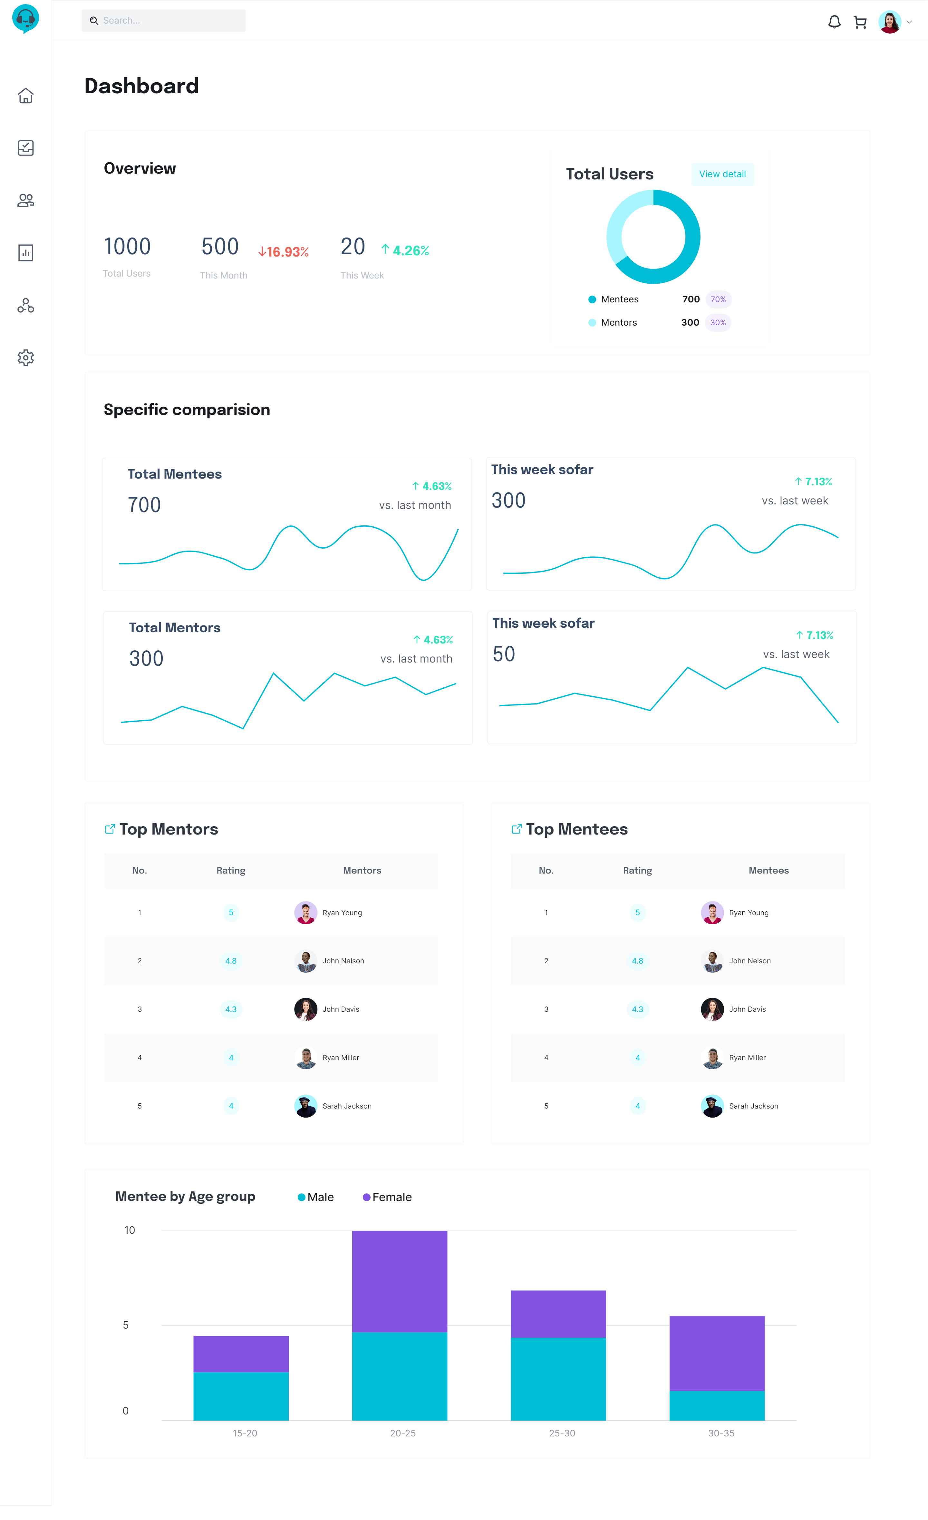
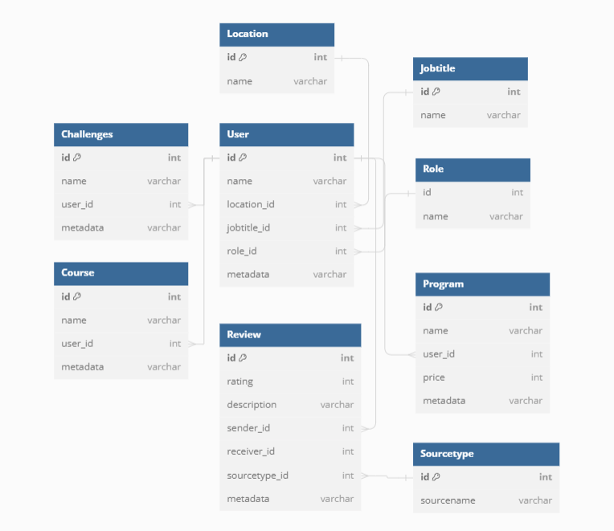
Admin/Dashboard

Slide 14

Questions & Answers

Slide 15


